Slide 1
Cloudera Impala

Slide 2
Overview of Impala
Architecture & Technology
Installing & Using
Test & Issue

Slide 3
Summary
Impala is very fast(response in few seconds) when it dose small data (<10G).
However, more large data, more bad performance (10~100G).
It should lose response while data size is very large (>100G).
It’s not very robust, some SQL make it crash.

Slide 4
Summary
Impala must run with Hive.
It use Hive’s metastore by sharing same remote meta data store service(such as MySQL).
Impala have same SQL syntax with Hive.
Exclude all DDL statements that are not supported today.
Impala has individual SQL grammar file & parser which is different with Hive.

Slide 5
Summary
Impala borrow design from parallel DB which architecture is called MPP.
Impala is different with Google’s Dremel which based on a special storage format and not support join operator.
Impala dose not replace Hive.

Slide 6
Typical Use Case of Impala
Pre-analysis
Optimizing analysis SQL with impala before Hive batch processing.
Processing sampling data(just process few partition data).
Statistics base on result of Hive
Hive analyze data, Impala build last data for diagram or report.

Slide 7
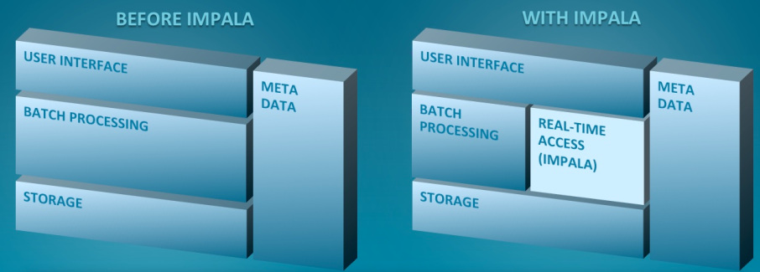
Role of Impala in Hadoop Ecosystem

Slide 8
Overview of Impala
Architecture & Technology
Installing & Using
Test & Issue

Slide 9
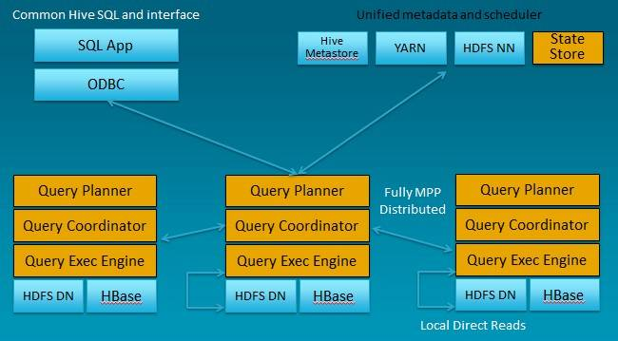
MPP Architecture of Impala

Slide 10
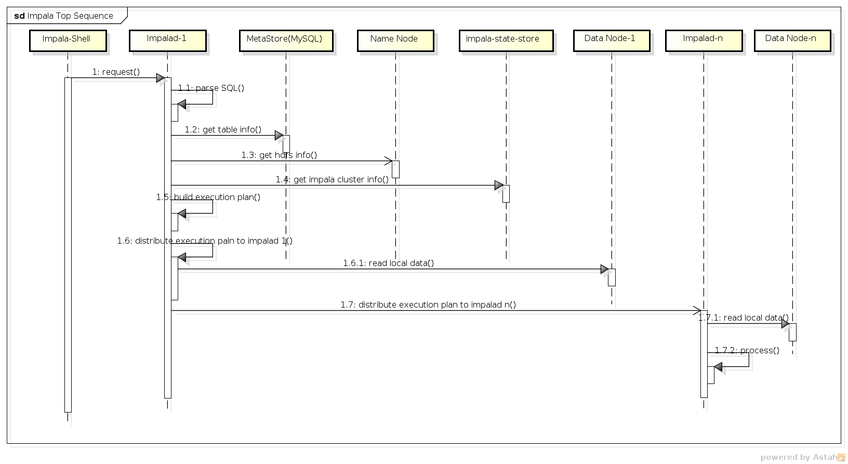
Impala Top Sequence

Slide 11
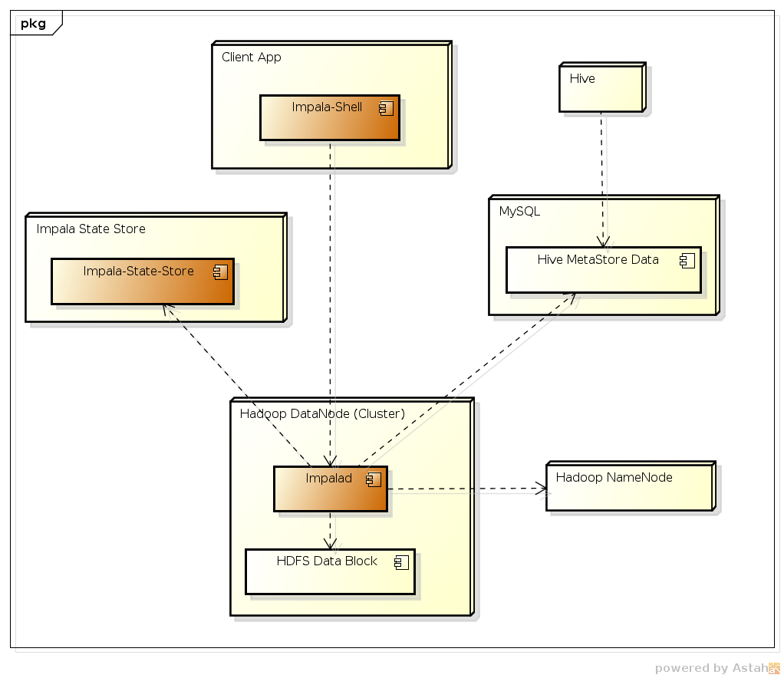
Impala Logic Deployment Model
Impala core component

Slide 12
Impala Component
impalad - The impala daemon. Plans and executes queries against HDFS and HBASE data. There should be one daemon process running on each node in the cluster that has a data node.
impala-shell - Command-line interface for issuing queries to the impala daemon.
impala-state-store - Name service that tracks location and status of all impalad instances in the cluster.

Slide 13
Impala Source Code Structure
./fe
Front end: communicate with user interface, parse sql, build execution paln, default listening in port 21000, code by Java.
./be
Back end: read local data, execute plan, transport data each other in default port 22000, code by C++
./shell
User interface, code by Python.

Slide 14
Overview of Impala
Architecture & Technology
Installing & Using
Test & Issue

Slide 15
Agenda
Overview of Impala
Architecture & Technology
Installing & Using
Test & Issue

Slide 16
Performance Test
Table Size SQL Statement | uservisits_i: 14,400,000(2.5G) rankings_i: 1,320,000(90M) | uservisits_i: 144,000,000(24G) rankings_i: 13,200,000(0.9G) | uservisits_i: 344,000,000(56G) rankings_i: 33,200,000(2.3G) | uservisits_i: 644,000,000(110G) rankings_i: 63,200,000(4.4G)
select count(*) from uservisits_i; | Hive cost: 20s Impala cost: 1s | Hive cost: 79s Impala cost: 28s | Hive cost: 184s Impala cost: 93s | Hive cost: 180s Impala cost: 252s
SELECT sourceIP, SUM(adRevenue) FROM uservisits_i GROUP BY sourceIP limit 1; | Hive cost: 59s Impala cost: 12s | Hive cost: 119s Impala cost:80s | Hive cost: 211s Impala cost: 187s | Hive cost: 358s Impala cost: NO RESPONSE
SELECT sourceIP FROM rankings_i R JOIN uservisits_i UV on (R.pageURL = UV.destURL) limit 1; | Hive cost: 53s Impala cost: 17s | Hive cost: 114s Impala cost:205s | Hive cost: 264s Impala cost: 230s | Hive cost: 651s Impala cost: NO RESPONSE

Slide 17
Test cases are from hivebench. But there are some issues to run with impala directly(Incorrect execution result: returned 0 row), cases were simplified and transformed.
In test report, NO RESPONSE means that response time>15min
Test environment: 4 Servers(WLB-NHM): X5570 @ 2.93GHz Mem:48G
There are many bugs and issue which Cloudera announce to fix in future.

